Slide 1

Football Management System

Slide 2
Team Members NAME: Nusrat Rahman Aurna ID: 2023-3-60-057 NAME: Sadia Hasan Munmun ID: 2023-3-60-070 NAME: Zeba Tahira ID: 2023-3-60-076 NAME: Abdullah Al Usaeed Chowdhury ID: 2023-3-60-028

Slide 3
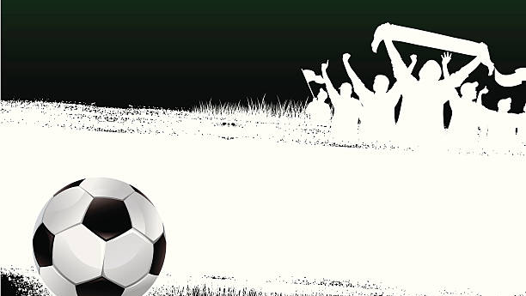
The goal of the Football Management System is to simplify and streamline football-related tasks. It focuses on efficiently managing teams, players, coaches, match schedules, and other operations, providing a centralized platform for all football management needs.

Slide 4

UML DIAGRAM

Slide 5

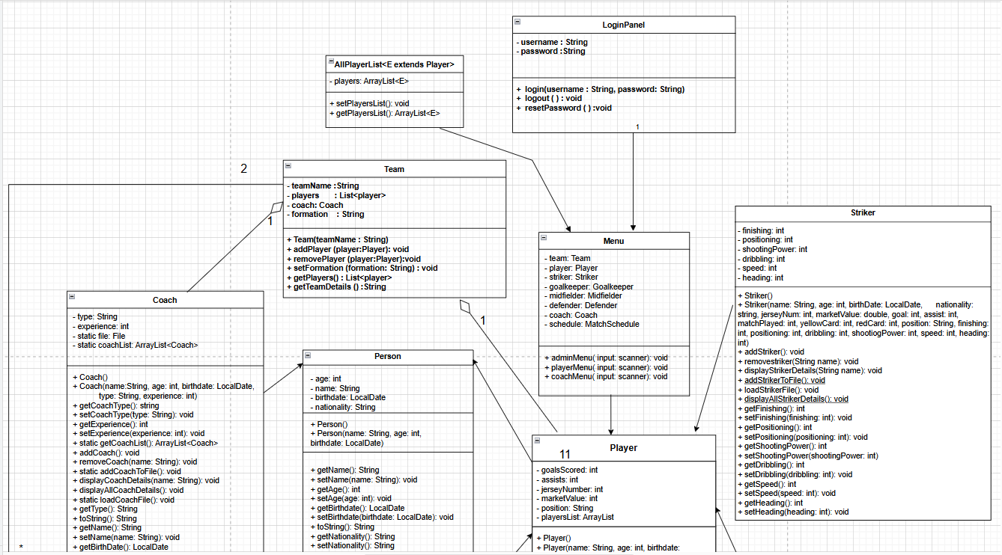

Slide 6
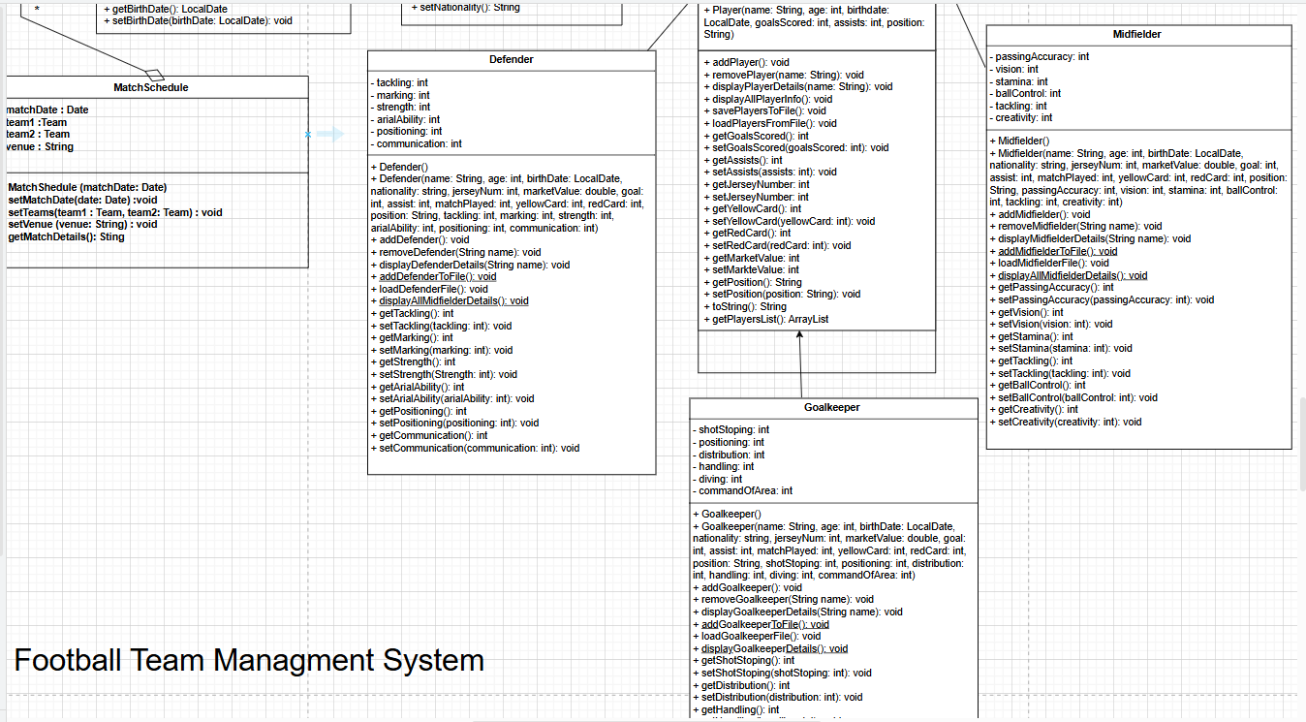


Slide 7

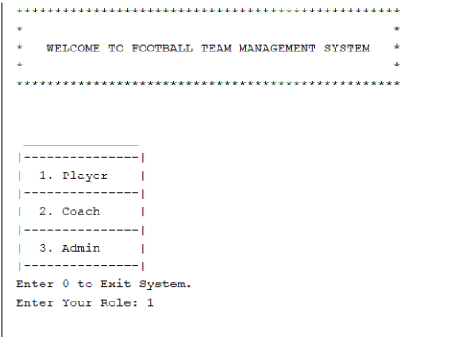
We added a method in the main method Football Management System where the user verifies their credentials for role-based access.

Slide 8
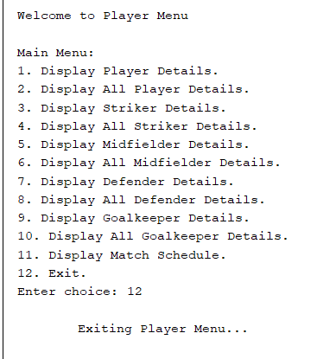
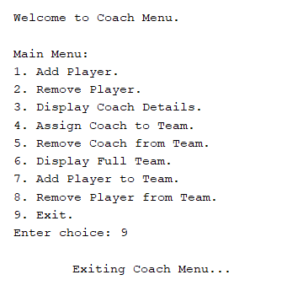
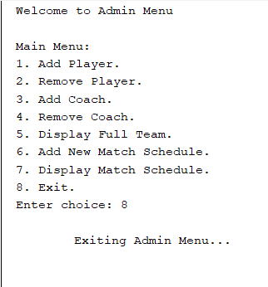
Then the Main menu opens according the role, from where
we can get the player menu, coach menu,
and admin menu.

Slide 9

C0NCLUSION
The Football Management System Java project effectively combines different features to handle teams, players, matches, and performance information. It offers a simple way for administrators to keep track of team stats, set up matches, and handle player details. The system shows how to use object-oriented programming in a useful way and offers an easy-to-use interface to help with managing and making decisions in the sport.

Slide 10

THANK YOU

